Slide 1
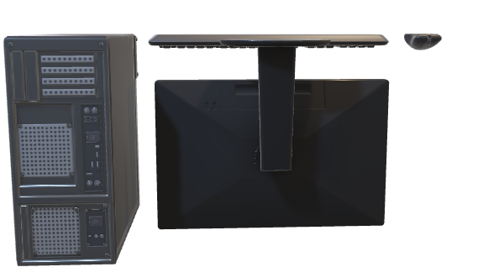
Input Output Organization

Slide 2
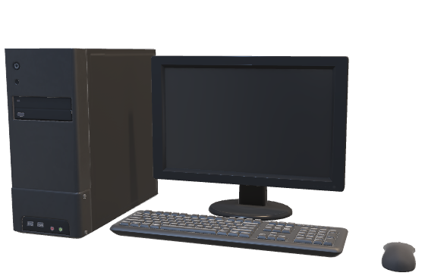
Input Output Organization

Slide 3
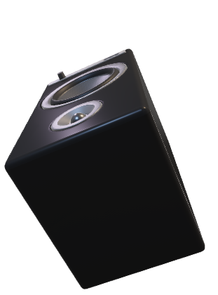

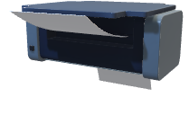
Input Output Organization
1) The input-output subsystem of a computer, referred to as I/O, provides an efficient mode of communication between the central system and the outside environment.
2) A computer serves no useful purpose without the ability to receive information from an outside source and to transmit results in a meaningful form.
3) When input information is transferred to the processor via a slow keyboard, the processor will be idle most of the time while waiting for the information to arrive.

Slide 4


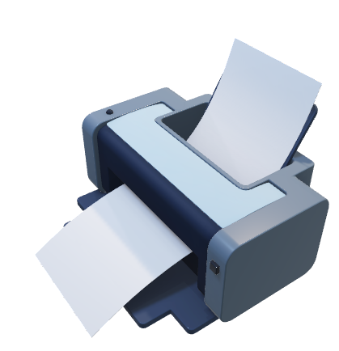
Peripheral Devices
1
Input or output devices attached to the computer are also called peripherals.

Slide 5
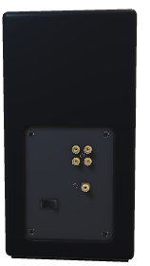
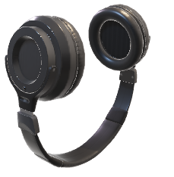
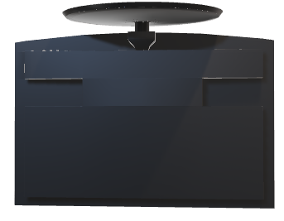
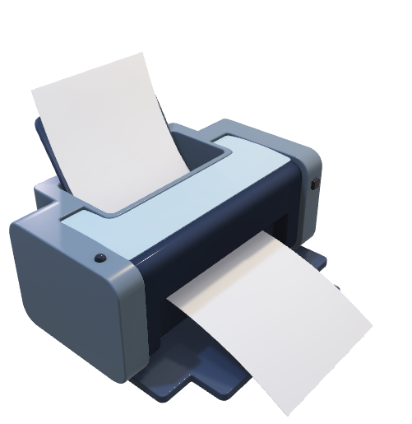
Printer
1
Printers provide a permanent record on paper of computer output data or text. There are three basic types of character printers: daisywheel, dot matrix, and laser printers.
Laser printers are the most advanced types of printers among all.
The laser printer uses a rotating photographic drum that is used to imprint the character images. The pattern is then transferred onto paper in the same manner as a copying machine
2

Slide 6
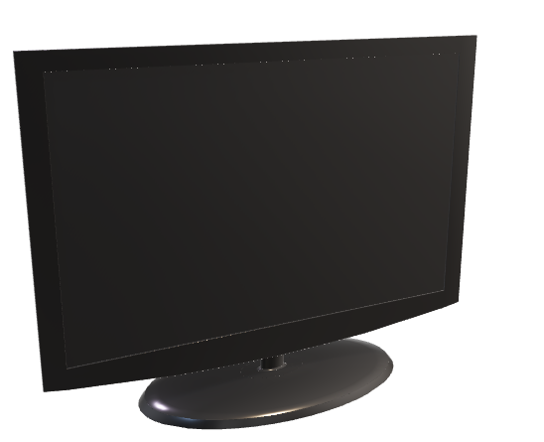
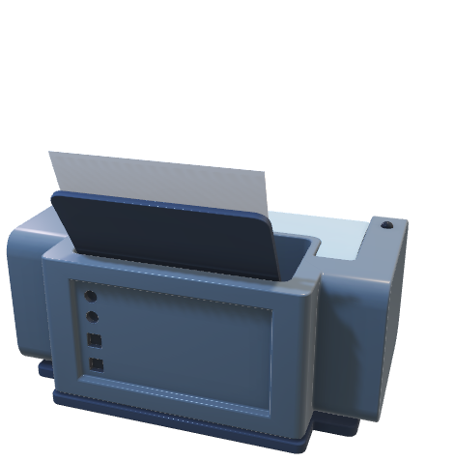
Monitor
2
Video monitors are the most commonly used peripherals. They consist of a keyboard as the input device and a display unit as the output device.
There are different types of video monitors, but the most popular use a cathode ray tube (CRT).

Slide 7

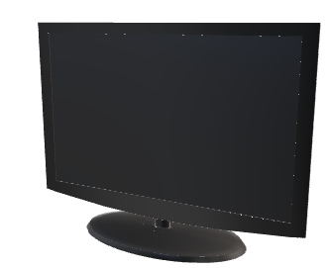
Monitor
The CRT contains an electronic gun that sends an electronic beam to a phosphorescent screen in front of the tube. The beam can be deflected horizontally and vertically.
To produce a pattern on the screen, a grid inside the CRT receives a variable voltage that causes the beam to hit the screen and make it glow at selected spots.
Horizontal and vertical signals deflect the beam and make it sweep across the tube, causing the visual pattern to appear on the screen.
2

Slide 8
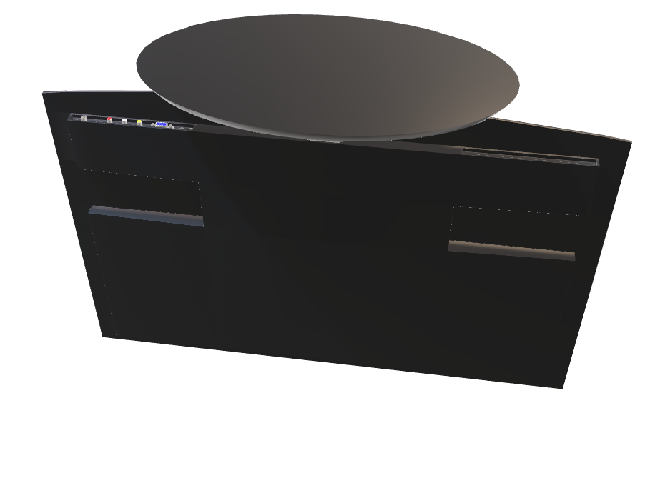
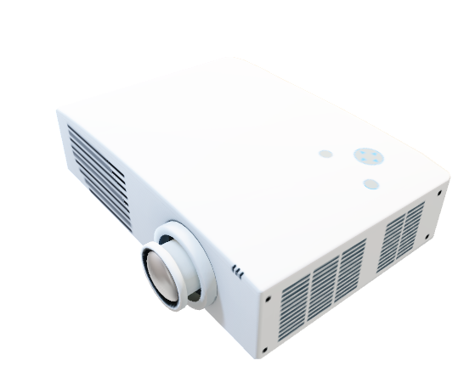
Projector
3
A projector or image projector is an optical device that projects an image (or moving images) onto a surface, commonly a projection screen.
Most projectors create an image by shining a light through a small transparent lens, but some newer types of projectors can project the image directly, by using lasers

Slide 9
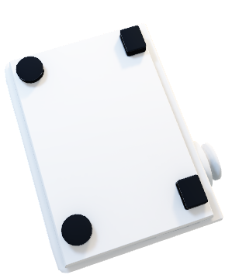
Input Output Interface
3
Input-output interface provides a method for transferring information between internal storage and external I/0 devices.
Peripherals connected to a computer need special communication links for interfacing them with the central processing unit
The purpose of the communication link is to resolve the differences that exist between the central computer and each peripheral. Some of the differences are:

Slide 10
Input Output Interface
Peripherals are electromechanical and electromagnetic devices and their manner of operation is different from the operation of the CPU and memory
The data transfer rate of peripherals is usually slower than the transfer rate of the CPU, and consequently, a synchronization mechanism may be needed.
The operating modes of peripherals are different from each other and each must be controlled so as not to disturb the operation of other peripherals connected to the CPU.

Slide 11

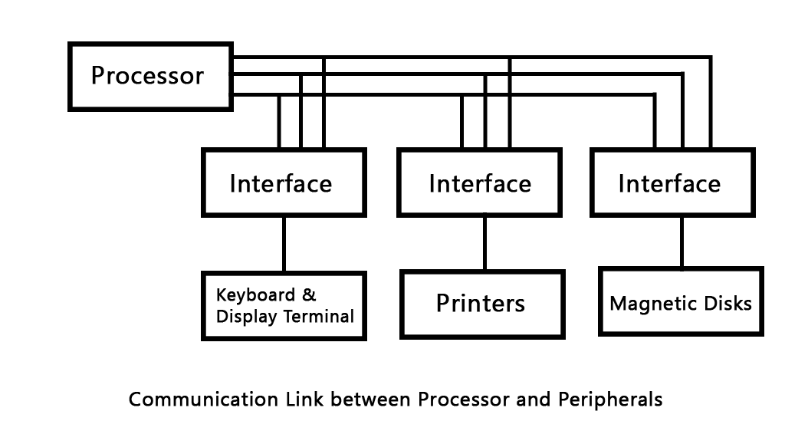
I/O Bus Diagram
Control
Data
Address

Slide 12
I/O Bus Diagram
Data
i/o Bus
Address
Control

Slide 13
I/O Bus-Lines
i/o Bus
Data
Address
Control
Data Line is used to allocate some data from the processor to the peripheral devices and vice-versa.
Address line is used to pass an address so that the interface can recognize which peripheral device to activate.
The function of control line is to provide various types of instructions that can be performed by the devices.

Slide 14
Input Output Vs Memory Bus

Slide 15
Input Output Vs Memory Bus
In addition to communicating with i/o, the processor must communicate with the memory unit. Like the i/o bus, the memory bus contains data, address, and read/write control lines. There are three ways that computer buses can be used to communicate with memory and i/o:

Slide 16


Ways to communicate with memory and input output devices
1) Use two separate buses, one for memory and the other for i/o
2) Use one common bus for both memory and i/o but have separate control lines for each. (control signal & read/write signal)
3) Use one common bus for memory and i/o with common control lines.

Slide 17


ThankYou!!!

Slide 18
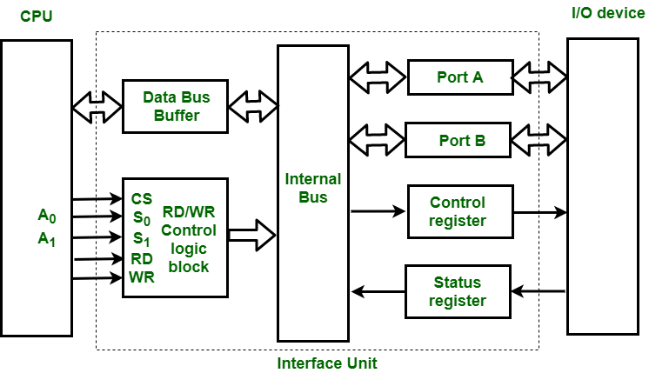
Ways to communicate with memory and I/O

